Slide 1
Uva 1482
Playing with Stones
Jakarta, LA 5059
Time: 3 seconds

Slide 2
Problem Description (1/3)
You and your friend are playing a game in which you and your friend take turns removing stones from piles.
Initially there are N piles with a₁, a₂, a₃, . . . , a_{N} number of stones. On each turn, a player must remove at least one stone from one pile but no more than half of the number of stones in that pile.

Slide 3
Problem Description (2/3)
The player who cannot make any moves is considered lost. For example, if there are three piles with 5, 1 and 2 stones, then the player can take 1 or 2 stones from first pile, no stone from second pile, and only 1 stone from third pile. Note that the player cannot take any stones from the second pile as 1 is more than half of 1 (the size of that pile).

Slide 4
Problem Description (3/3)
Assume that you and your friend play optimally and you play first, determine whether you have a winning move. You are said to have a winning move if after making that move, you can eventually win no matter what your friend does.

Slide 5
Input
The first line of input contains an integer T (T ≤ 100) denoting the number of testcases.
Each testcase begins with an integer N (1 ≤ N ≤ 100) the number of piles.
The next line contains N integers a₁, a₂, a₃, . . . , a_{N} (1 ≤ a_{i} ≤ 2 ∗ 10¹⁸) the number of stones in each pile.

Slide 6
Output
For each testcase, print ‘YES’ (without quote) if you have a winning move, or ‘NO’ (without quote) if you don’t have a winning move.

Slide 7

Sample Input / Output
Number of test cases
4
2
4 4
3
1 2 3
3
2 4 6
3
1 2 1
NO
YES
NO
YES
Number of piles
Number of Stones in each piles
先
後
先
後
先敗
(4,4)→
(2,4)→
(2,2)→
(1,2)→
(1,1)→
先
後
先
後
先敗
(4,4)→
(3,4)→
(3,3)→
(2,3)→
(2,2)→

Slide 8
Nim Game
兩人輪流取銅板，每人每次需在某一 Pile 取一枚或一枚以上的銅板，但不能同時在兩 Piles 取銅板，直到最後，將銅板拿光的人贏得此遊戲。(In other words, 不能拿的輸)

Slide 9
Examples
Case 1:
A 拿 1
B 拿 1
A 拿 1
B 不能拿
A勝
Case 2:
B 拿 1
A 拿 1
A 不能拿
B 勝
B 拿 1
A 拿 1

Slide 10
Examples
Assumptions:
我們都需要假設雙方都是足夠聰明的
因此就會存在有判斷「先手勝」 或是「先手敗」 ，若是可以贏，不會故意不贏
Case 1:
先手勝
A 全拿
B 不能拿
A勝
Case 2:
先手敗
A 全拿
A 不能拿
B 勝
B 全拿

Slide 11
Case 2:
先手敗
A 拿 1
A 不能拿
B 勝
A 拿 1
B 拿 1
B 拿 1

Slide 12
Nim Sum
0 1
(1, 2, 3)
1 0
1 1
⊕
==0, 先手敗
0 0
!=0, 先手勝

Slide 13
Nim Sum
1 1 1 1
1 1 0 0
(15, 6, 10)
0 1 1 0
0 1 1 0
1 0 1 0
1 0 1 0
⊕
⊕
0 0 1 1
0 0 0 0
!=0 先手勝

Slide 14
SG(Sprague-Grundy) Function
SG函数，SG(x)=mex{ SG(y) | x→y }，
就是状态x能转移到y
mex(Y)表示非Y集合中最小的自然数
Example : mex(0,2)=1 mex(1,3)=0

Slide 15
只考虑一堆石头的情况
Recursive
SG(0)=0
因为(0)没有后继，所以自然SG(0)=0
SG(1)= mex(SG(0)=0)=1
SG(2)= mex(SG(0)=0, SG(1)=1)=2
...
SG(n)=n

Slide 16
考虑兩堆石头的情况
Recursive
SG(0,0)=0
SG(0,1)=SG(1,0)=mex(SG(0,0)=0)=1
SG(0,2)=SG(2,0)=mex(SG(0,1)=1 SG(0,0)=0)=2
...
SG(a,b)=a⊕b

Slide 17
考虑三堆石头的情况
Recursive
SG(0,0,0)=0
SG(0,0,1)=SG(0,1,0)=SG(1,0,0)=mex(SG(0,0,0)=0)=1
SG(0,1,1)=SG(1,1,0)=SG(1,0,1)=mex(SG(0,0,1)=1 SG(0,1,0)=1…)=0
...
SG(a,b,c)=a⊕b⊕c=SG(a)⊕SG(b)⊕SG(c)

Slide 18
本題的 SG Function
考慮一堆石頭的時候:
SG(1)=0 why???
SG(2)=mex{SG(1)=0}=1
SG(3)=mex{SG(2)=1}=0
SG(4)=mex{SG(3)=0, SG(2)=1}=2
SG(5)=mex{SG(4)=2,SG(3)=0}=1
...
n | 1 | 2 | 3 | 4 | 5 | 6 | 7 | 8 | 9 | 10 | 11 | 12 | 13 | 14
SG(n) | 0 | 1 | 0 | 2 | 1 | 3 | 0 | 4 | 2 | 5 | 1 | 6 | 3 | 7

Slide 19
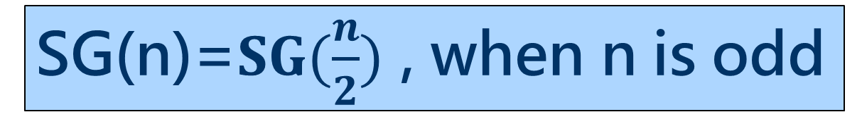
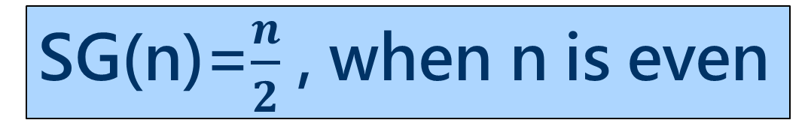
本題的 SG Function
n | 1 | 2 | 3 | 4 | 5 | 6 | 7 | 8 | 9 | 10 | 11 | 12 | 13 | 14
SG(n) | 0 | 1 | 0 | 2 | 1 | 3 | 0 | 4 | 2 | 5 | 1 | 6 | 3 | 7
SG(n)=$\frac{n}{2}$ , when n is even
n | 1 | 2 | 3 | 4 | 5 | 6 | 7 | 8 | 9 | 10 | 11 | 12 | 13 | 14
SG(n) | 0 | 1 | 0 | 2 | 1 | 3 | 0 | 4 | 2 | 5 | 1 | 6 | 3 | 7
n | 1 | 2 | 3 | 4 | 5 | 6 | 7 | 8 | 9 | 10 | 11 | 12 | 13 | 14
SG(n) | 0 | 1 | 0 | 2 | 1 | 3 | 0 | 4 | 2 | 5 | 1 | 6 | 3 | 7
SG(n)=$SG(\frac{n}{2})$ , when n is odd

Slide 20
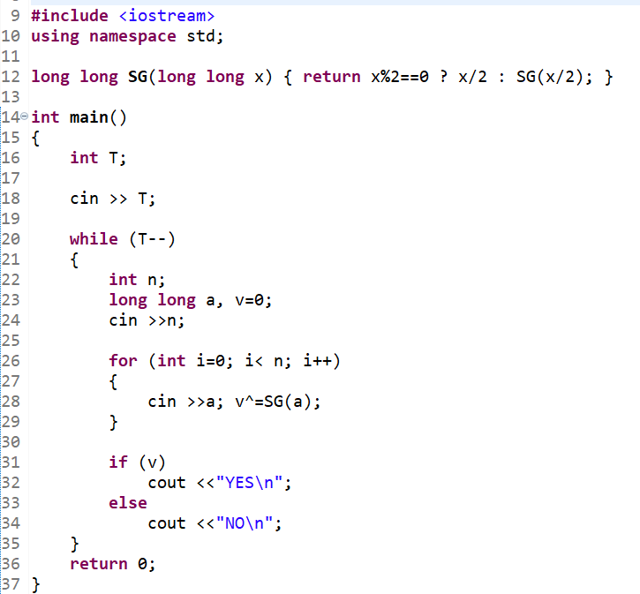
Sample
Code

